Slide 1
Palo Alto Networks and
Private Wireless Security
UPTIME 2023
Mitch Rappard
Principal Solutions Architect
v1.0

Slide 2
Security Challenges in Mobile Networks
Limited Security Controls
Outdated Threat Protection
Rising Alerts
Opaque environment with no user or device level security controls
Inadequate protection against advanced and evasive exploits, malware and threats
Too many alerts across many security tools and not enough people to handle them
Notes:
the average global enterprise uses 75+ different point security products; the issue is that the space is fragmented and most providers lack the ability to stitch all of the problems being solved ideally with one platform (or in our case - 3 platforms)

Slide 3
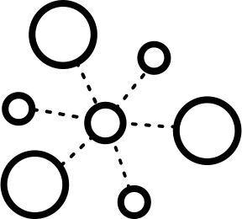
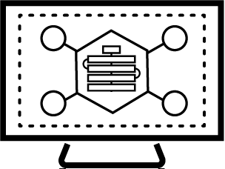
Our Platform Approach (We aren’t just a NGFW company)
Full Content Visibility
& Control
Cloud Workload Protection
Automated Security
Device/Subscriber, Application/Service and Threat Aware
Visibility to Actionable Intelligence in real-time
Security Operations
Dynamic Security Enforcement for vulnerabilities, malware, antivirus, URL, C2. Device, Subscriber and Slice aware.
Single, unified agent to secure cloud VMs, containers and Kubernetes apps, and serverless functions
Playbooks, Extensible product integrations, Case management, Communication and collaboration
Notes:
A security platform requires a great foundation.Mobile operators need to develop a robust and comprehensive end-to-end security strategy that encompasses all traffic (data, control and signaling planes) to protect their networks and provide a safe environment for their customers.
Start with complete visibility across entire network - Identify infected devices and prevent device-initiated attacks. Detect / Stop suspicious signaling events, malformed packets, IoT Malware & Unauthorized C2 attacks. IMSI-IMEI (4G) SUPI/PEI (5G) threat correlation
Apply cloud based threat intelligence to provide rapid response to threats (<5 mins response to unknown threats), Data driven threat prevention provides contextual security outcomes. (Machine Learning capabilities) ML classifiers ensures that the malware was blocked at first sight, deep learning models helped associate the threat with the correct malware family. This automated process protected your network on a global scale, in real-time.
Granular security enforcement and Equipment and Subscriber ID correlation to threats on a per-slice basis is key.

Slide 4
A Private Wireless Security Checklist
Private Wireless Security Checklist
Visibility
Do you have granular visibility to your mobile traffic?
Can you enforce security policies per user, device or application?
Can you generate reports about suspicious activity in the network?
Prevention
Can you detect known, unknown and evasive threats in mobile traffic?
Can you detect anomalous behavior of your IoT/OT devices?
Response
Can you identify infected devices and take action in real time?
Can you log mobile security events for potential incident response?

Slide 5
Zero Trust is a security strategy designed to prevent breaches by eliminating trust in the digital world while consistently verifying all users, devices, and applications across all locations.
Notes:
Zero Trust is a strategic initiative that helps prevent successful data breaches by eliminating the concept of trust from an organization’s network architecture. Rooted in the principle of “never trust, always verify,” Zero Trust is designed to protect modern digital environments by leveraging network segmentation, preventing lateral movement, providing Layer 7 threat prevention, and simplifying granular user-access control.
Zero Trust was created by John Kindervag, during his tenure as a vice president and principal analyst for Forrester Research, based on the realization that traditional security models operate on the outdated assumption that everything inside an organization’s network should be trusted. Under this broken trust model, it is assumed that a user’s identity is not compromised and that all users act responsibly and can be trusted. The Zero Trust model recognizes that trust is a vulnerability. Once on the network, users – including threat actors and malicious insiders – are free to move laterally and access or exfiltrate whatever data they are not limited to. Remember, the point of infiltration of an attack is often not the target location.
According to The Forrester Wave™: Privileged Identity Management, Q4 2018, This trust model continues to be abused credentials.1 Zero Trust is not about making a system trusted, but instead about eliminating trust.
===========
As a company, we believe that Zero Trust is the cybersecurity strategy to successfully prevent data breaches by eliminating trust and by always verifying all users/devices/applications across all locations.
Zero Trust is a cyber security strategy that prevents successful data breaches. With Zero Trust, you cannot trust or assume what happens before or after each hop in the infrastructure. Every device, application and microservice is responsible for its own security. With each step a user makes through the infrastructure, you need to validate, authenticate and apply threat prevention capabilities across all locations.
Zero Trust is what drives our core philosophy and our product portfolio.
There are no Zero Trust products. There are products that work well in Zero Trust environments, and products that don’t.

Slide 6
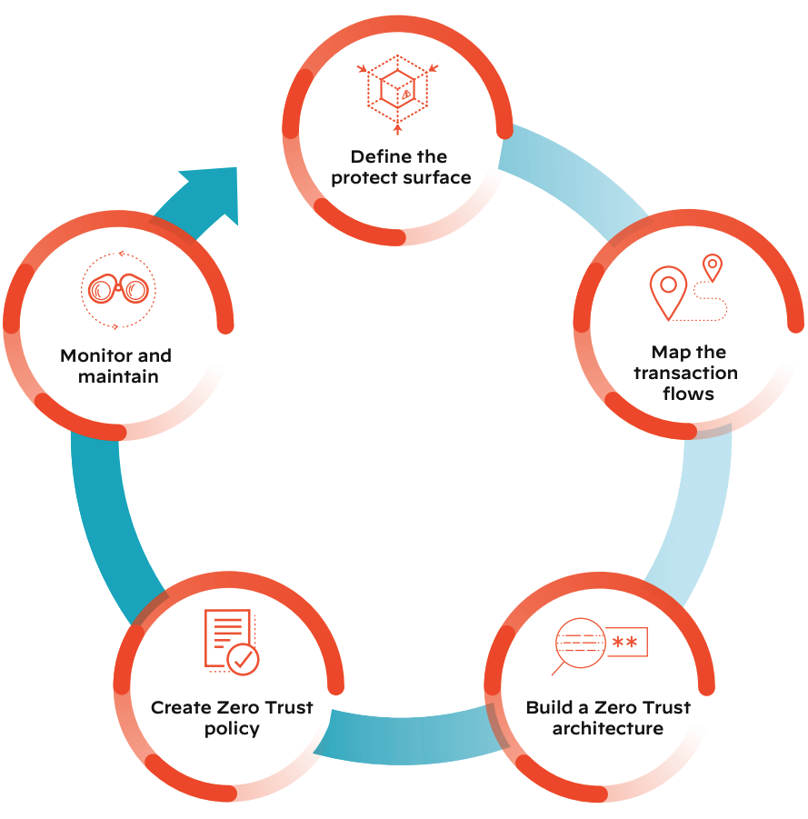
Deploying Zero Trust Networks
Zero Trust augments your existing network
The Zero Trust network is interconnected with your existing network to take advantage of the technology you already have
By following a five-step methodology deployment of your Zero Trust network can be accomplished with relative ease

Slide 7
Zero Trust Policies
To create a zero trust policy, you must know the following for every flow on the network:
Who is the asserted identity
What is the application used by the asserted identity
Where is the identity trying to access the resource
When is the resource being accessed
Why pertains to data classification
How is the asserted identity accessing the protect surface
Knowing the Identity or the “Who” of mobile networks requires security solutions that understands mobile identifiers

Slide 8
APK
file type
web-browsing
application
facebook.apk
file name
3150100014xxxx
IMSI
HTTP
protocol
unknown
URL category
35966827023xxxx
IMEI
SSL
protocol
canada
destination country
172.16.1.10
source IP
TCP/443
destination port
64.81.2.23
destination IP

Slide 9
Determining Identity - “Who”
Identity is critical in 4G/5G Networks
An IP address does not provide identity
In Mobile Networks, there are several key identities for all traffic flows
Subscriber ID - This is the IMSI in 4G and SUPI in 5G
Equipment ID - This is the IMEI in 4G and PEI in 5G
Slice ID - This the logical network in the 5G environment

Slide 10
5G Mobile Identifiers for Granular Policies and Threat Correlation
IMSI / SUPI
IMEI / PEI
MIoT, eMBB, URLCC
NSSAI - SST
IP TRAFFIC
SUBSCRIBER ID
DEVICE ID
NETWORK SLICE ID
SUBSCRIBER IP
SUBSCRIBER / DEVICE/ NETWORK SLICE CORRELATION TO THREAT
APPLICATION
THREAT/ MALWARE
APP ID
CONTENT ID
IMSI / SUPI - SIM Card ID 4G/5G
IMEI / PEI - Equipment ID 4G/5G

Slide 11
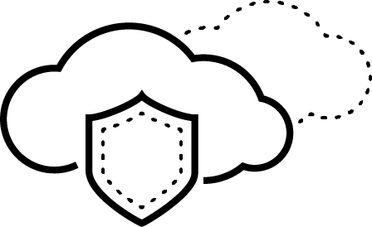
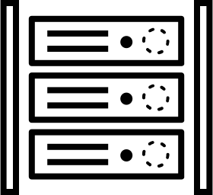
Comprehensive Private Wireless OT specific knowledge
AI/ML visibility engine for assets, apps & users across OT networks, wireless networks & remote operations
Visibility
ML-powered scalable discovery
Remote worker
Vendor
Apps
Remote users
ML-powered
Cloud-delivered
OT/IoT/IT/5G assets, devices, and protocols context
Historian
Server
CNC
Endpoint
Printer
Apps at layer 7 and users identity
PLC
BMS
Industrial Control System
Conveyer
Belt
Security
Camera
HVAC
OT assets
5G OT assets
IT/IoT devices
325+
Unique OT assets profiles
1,000+
OT/ICS App-Ids
600+
OT/ICS Threat Signatures
Notes:
ML-powered scalable discovery
Know and assess your OT threat surface with accurate devices, and apps visibility regardless of their connection technology. Our solution in the only one in the market to leverage machine learning for device, app and user discovery.
The ML technology scales seamlessly with your OT network to discover all passively and non-intrusively.
OT/IoT/IT/5G devices & protocols context
Our OT solution combines machine learning with our patented Device-ID, 5G equipment ID, App-ID™, User- ID technology and crowdsourced telemetry to quickly & accurately profile devices, apps and users.
The solution identifies OT protocols and communications to establish a comprehensive inventory of OT devices and helps understand what devices are most critical to the operation of the business.
Additionally with our ML solution you get accurate visibility of 5G traffic by identifying Subscriber-ID, Equipment-ID, and applications.
Apps at layer 7 and users identity
At Palo Alto Networks, we invented App-ID, User-ID and Device-ID - all of which deliver rich context and a more granular approach to allowing access to applications.
The App-ID capabilities are stateful - we continuously gather information about the TCP session, the application handshakes, the application behavior, the stateful protocols, and more

Slide 12
NEXT-GENERATION FIREWALLS: CONTINUED INNOVATION DELIVERS NUMEROUS FORM FACTOR OPTIONS
Next-Gen Firewall
VM/CN-Series Software Firewalls
Cloud NGFW
Best-In-Class Security — Virtual & Containerized
Cloud-Integrated, Automated, Easy to Manage
Best-in-Class Security
ML-Powered NGFW stops known and unknown threats in real time. 100% evasions blocked in Cyberratings.org testing.
Best-in-class NGFW delivered as a managed cloud-native service Enabled in a few clicks, Integrated with AWS Firewall Manager
Notes:
Our hardware firewalls are used for securing everything from small branch offices (where you need local security) to large campus locations as well as large data centers. Based on Cyberratings.org testing, we were able to block 100% of evasions, providing security that’s extremely difficult to evade.
Our software firewalls, on the other hand, are best for securing your applications in your public and private cloud environments. They are available as a virtual machine and a container form factor. They integrate well with any cloud and use cloud tools for automation. Panorama, our centralized management solution, allows you to manage network security for multi-cloud and hybrid cloud use cases from a centralized location.
For your cloud-native, or born-in-the-cloud apps, we recently introduced Cloud NGFW for AWS. It offers best in class security, and yet is very easy to enable since it is integrated with AWS Firewall Manager.

Slide 13
Security Services Use AI To Deliver Superior Protection
Good Data Makes for Great AI Our Security Services have a tremendous Network effect
AI + ML Deliver Zero-Day Detection The escalating threat landscape requires a new approach
Attack Prevention Happens Inline Moving detection inline prevents even the first attack
Each day we analyze 750 million new and unique objects
Each day we detect 1.5 million new and unique attacks that weren't there the day before
Each day we block* 8.6 billion attacks
Notes:
*estimated by averaging # preventions per FW where telemetry is enabled by the total # firewalls in use

Slide 14
Better Together : Athonet + Palo Alto Networks
Cost effective rapidly Deployed Mobile Private Networks with security built-in
Flexible deployment models with software based mobile core and Palo Alto Networks NGFW
Rapidly deploy in private or public clouds
Proven 10+ year track record for both private mobile deployments and Next-Gen security
Industry leading Zero Trust security extended to private mobile networks
Advanced Threat Prevention and correlation for rapidly responding to any security issues
Intuitive Interfaces for both the packet core and security network elements

Slide 16
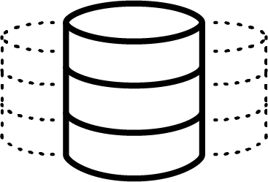
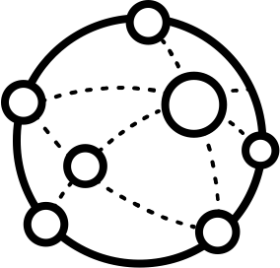
5G Threat Landscape
Virtualization
Containerization
Access Control
Application Vulnerability
Threats from untrusted peering interface
Mobile Users /
IoT Devices
Signaling threats
Resource Exhaustion
VIRTUALIZED CONTAINERIZED 5G CORE NETWORK
ROAMING NETWORKS
IoT/Things
Scans
DDoS
RAN
Industry Verticals
Gi / INTERNET
Service specific network slices
Malware
Bots DDoS
C&C attacks
Battery drain attacks
Remote Code Execution
Slice Isolation
Per Slice Threats
Edge Cloud vulnerability
Application Vulnerability
Privacy & Fraud
MEC
5G NFs

