Slide 1
Why 5G Positioning is a Foundational Application for 5G Private Networks

Slide 2

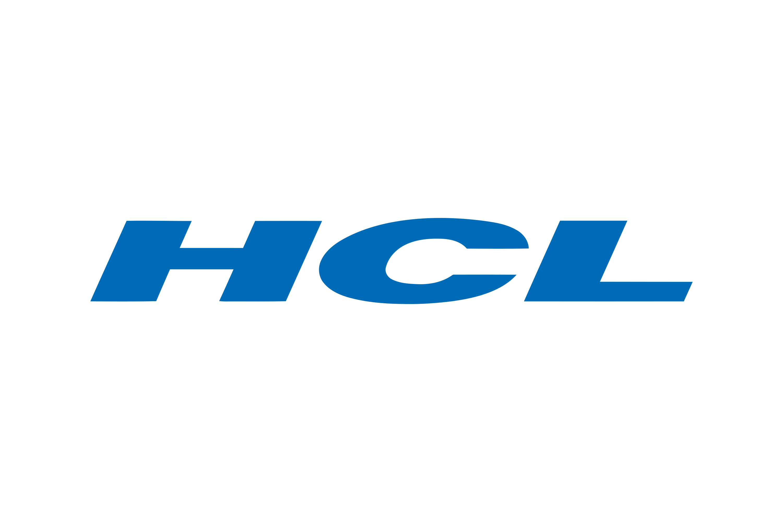
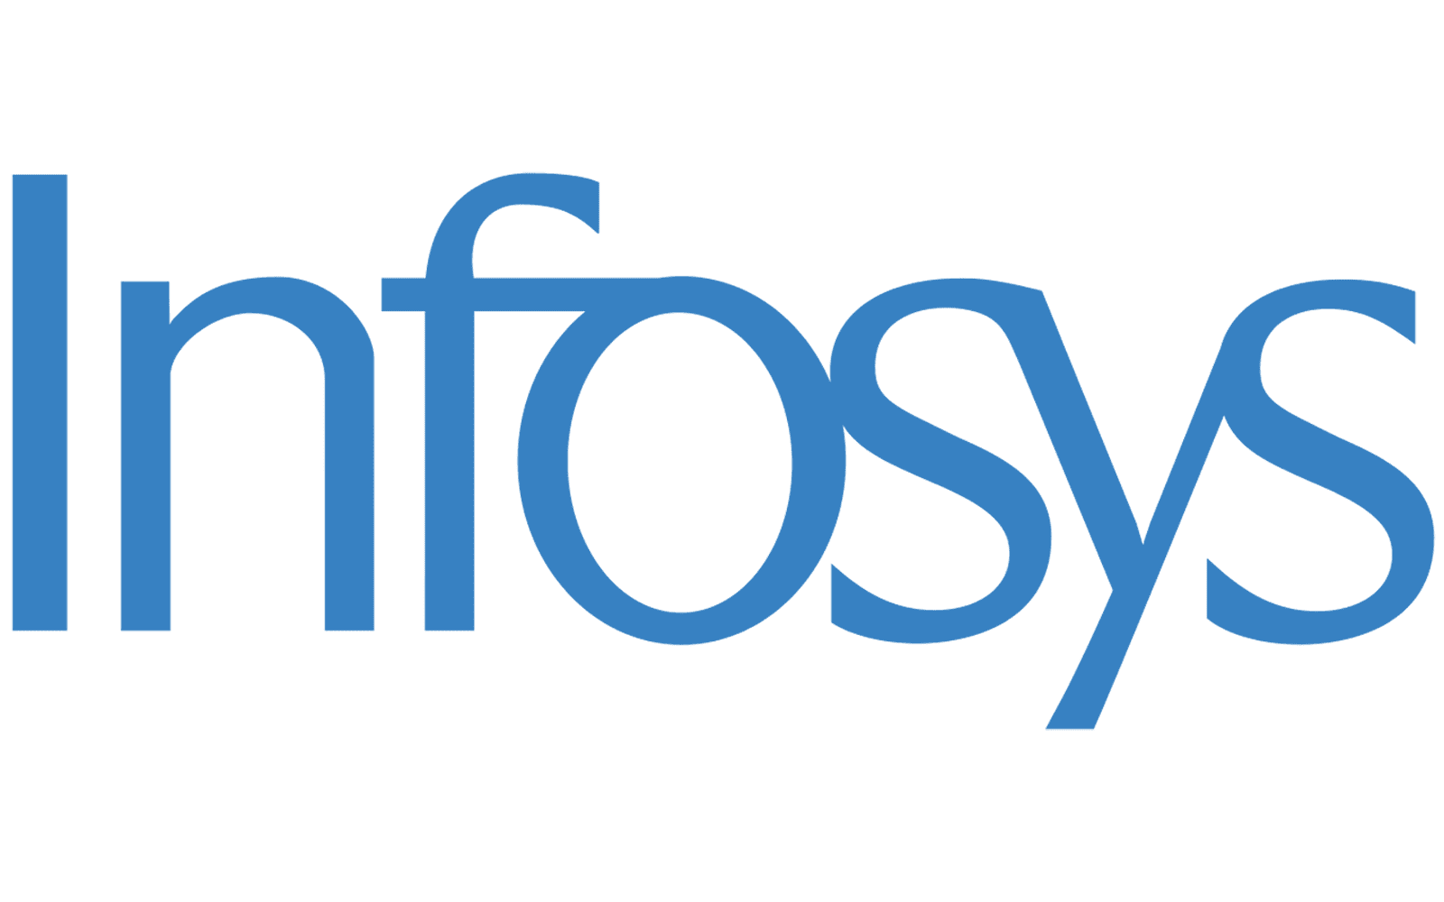


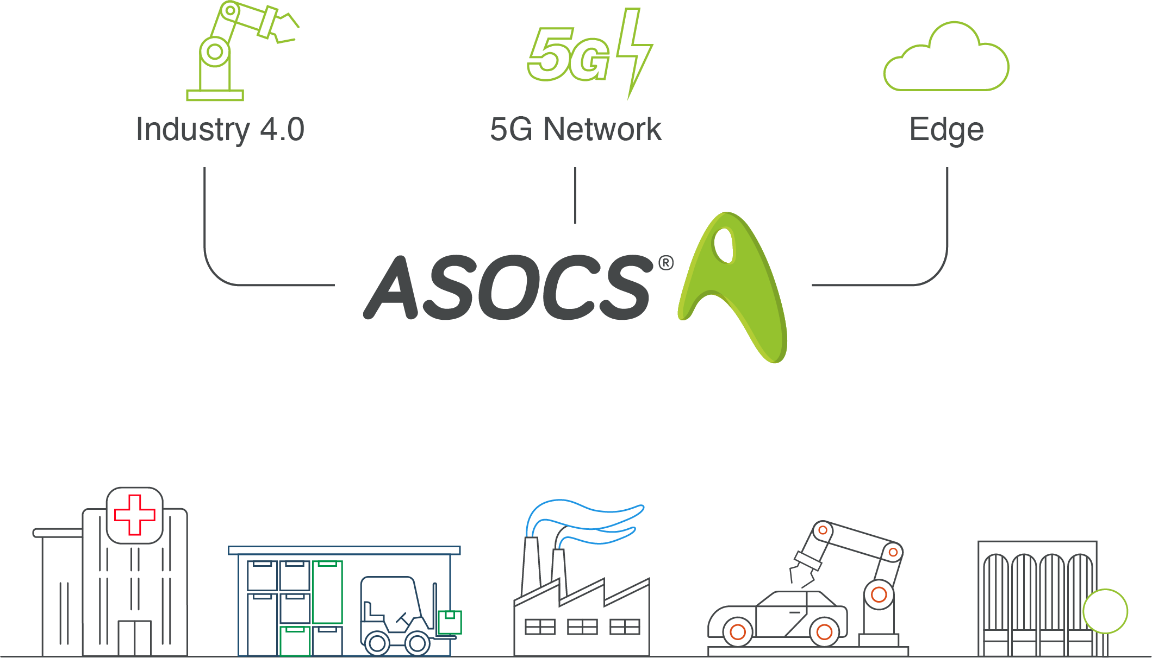
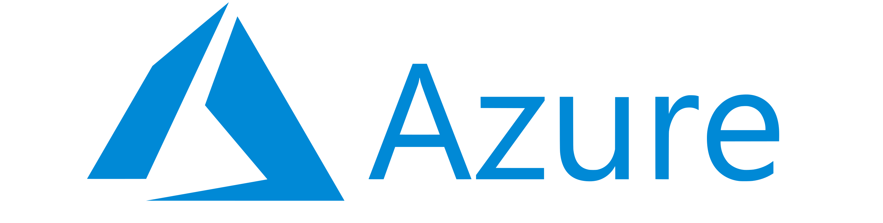
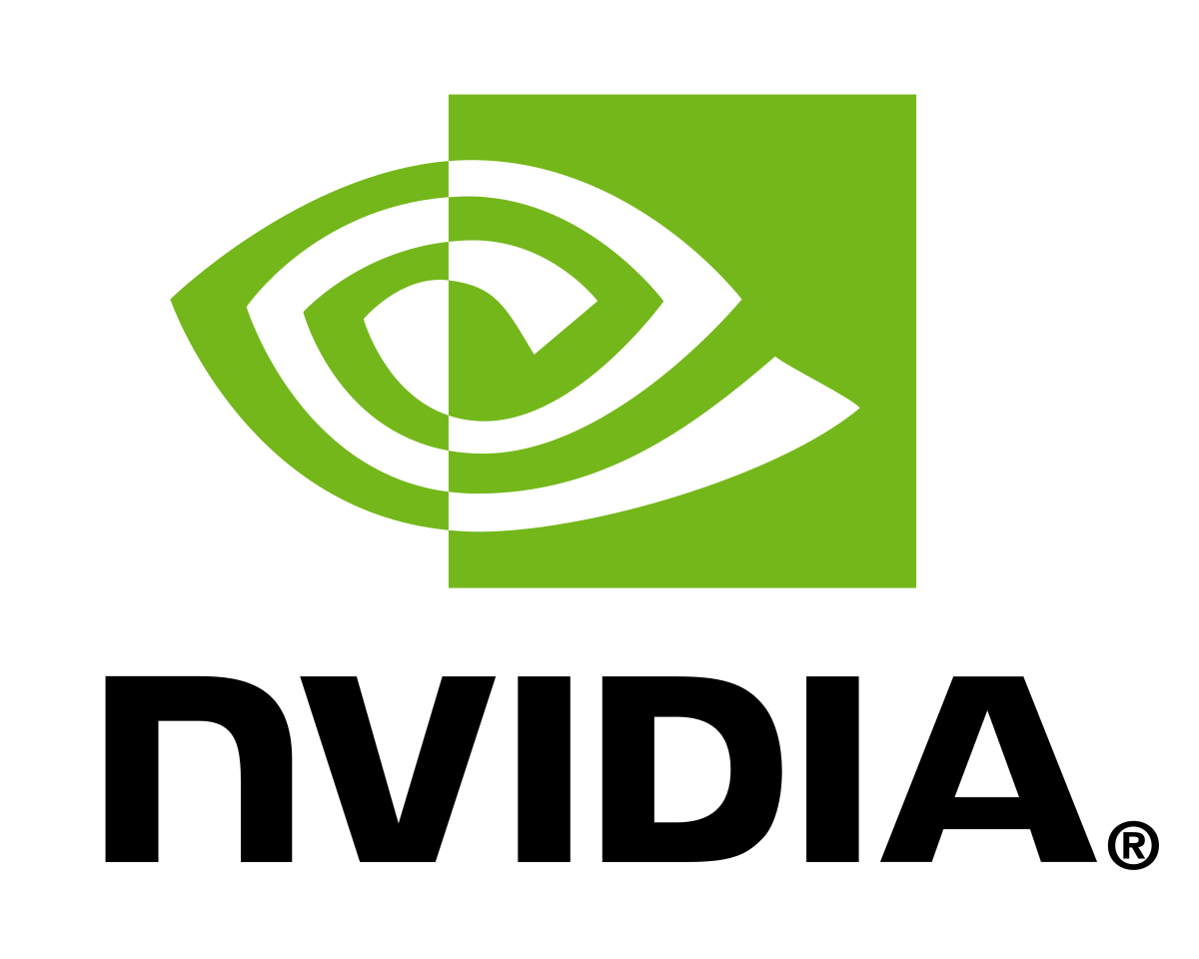


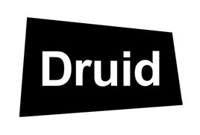

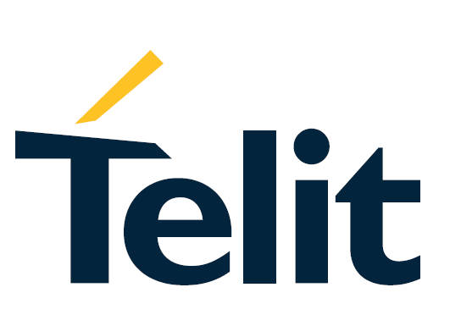


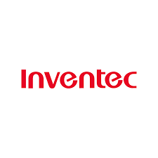



ASOCS at-a-Glance
ASOCS provides enterprises with cloud based 5G connectivity & positioning services designed for mission-critical, AI driven applications
World-leading Distribution Partners
E2E Cloud as Service partnership
Supported by world class partners
Investors
Tech partners
Founded in
2003
Pivoted
2014
HQ
in Israel
6
Global Offices
5 US patents
granted

Slide 3
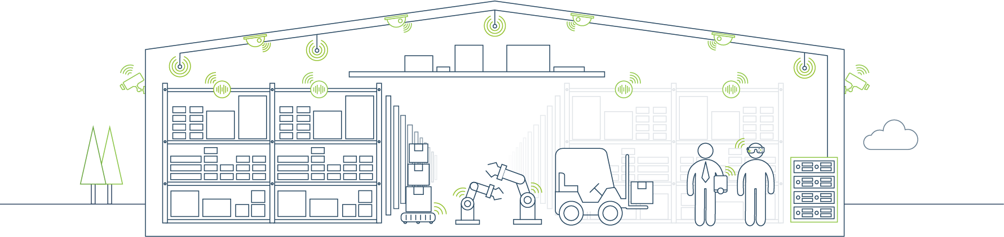
What is the Value of Positioning
350 Million
Man-hours per year
Lost Equipment Costs UK Manufacturing
Jan 2023 Industry Insight Pathfinder News
60%
50%
of vital tools not available when required
of organizations lose 2-3 hours of working time in an average week locating tools and components
Based on a survey of 250 industry professionals - Jan 2023 Industry Insight Pathfinder News

Slide 4

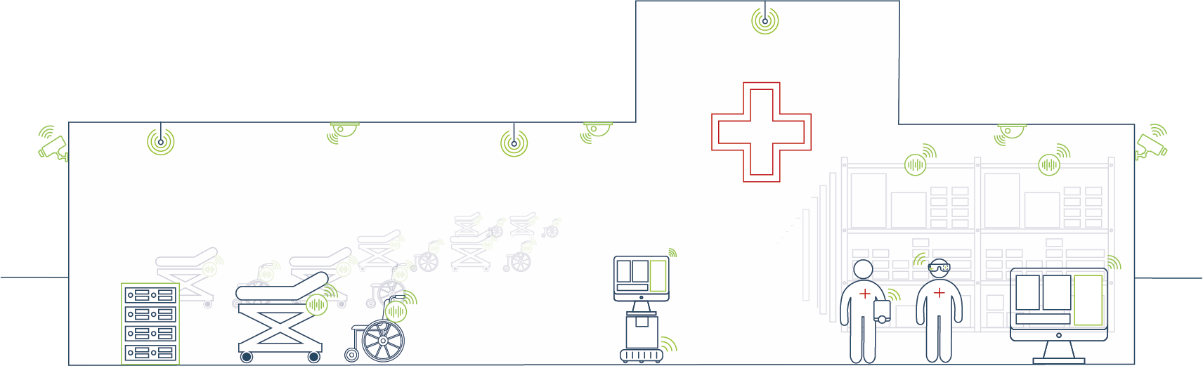

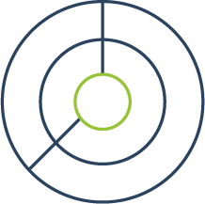
Value of Positioning in Healthcare
40
Hours per month searching for equipment
16%
10%
Longer time spent looking for equipment rather than with patients
Abandoned searches for equipment such as beds & wheelchairs
Research shows nurses waste hours per day searching for equipment, sometimes spending more time looking for equipment than with patients
Sources:
https://www.nursingtimes.net/archive/nurses-waste-an-hour-a-shift-finding-equipment-10-02-2009/ - https://www.healthcarefacilitiestoday.com/posts/MGM-Solutions-6000-Hours-Per-Month-Wasted-on-Nurses-Finding-Lost-Equipment--17611 - https://iottag.com.au/how-much-time-do-staff-waste-searching-for-equipment/

Slide 5
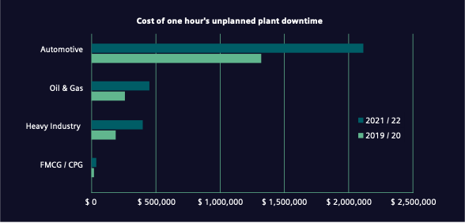
What is the Value of Positioning
Potential Impact of stopping work to locate tool/equipment
Cost of Downtime
Productivity Losses
Disruption of Workflow
Replacement Costs
Delay Penalties
$2M / hour
$475k / hour
$450k / hour
Siemens: The True Cost of Downtime 2022

Slide 6


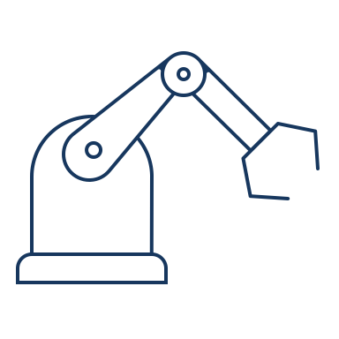




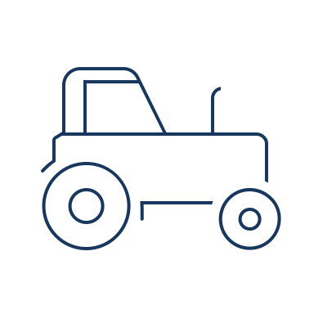



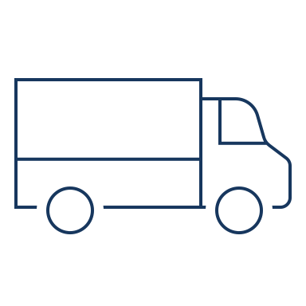




Verticals and Use Cases
Industry 4.0 | Smart Warehouse
Hospitals | Mines / Oil & Gas
Energy | Agriculture
Transportation | Smart Retail
Campus | Ports
Location
Critical & High-Value Assets, Tools, Equipment, Inventory
Safety & Security
Safety Zones
Geofencing, Security
5G Positioning enables the digitisation of industry
Tracking
AMRs, Robots,
On-Premise Vehicles
Movement Analytics
Vehicle/ People Traffic Flow
Material Handling

Slide 7



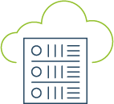





Accurate Positioning leads to Actionable Insights
Actionable Insights | Data Insights
 | Geofencing Analytics
 | Mobility/ Dwell Time
 | Route Optimization
 | Process Optimization
 | Resource Allocation
 | Inventory Management
Geolocation
Output
Application
Layer
Visualization
Dashboard

Slide 8



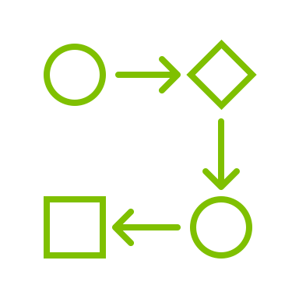






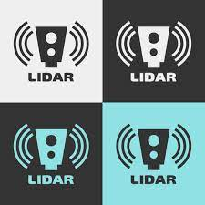

Existing RTLS vs 5G Positioning
Existing RTLS
Considerations
5G Positioning
Accuracy
Application
Installation Complexity
Accuracy > 90% Use cases
Existing Infrastructure
Nothing on Device
Cost Effective
Secure
UE Battery Life
Solution Cost
Security
Siemens: The True Cost of Downtime 2022

Slide 9
Hermes-NGP Introduction
Positioning is a foundational application for 5G Private Networks
Positioning as an add-on application
Hermes-NGP offers indoor and outdoor real-time location information
Essential part of Industry 4.0 digitization
Uses existing 5G Private Network Infrastructure – No overlay network

Slide 10


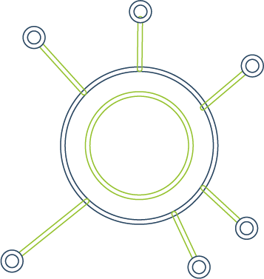
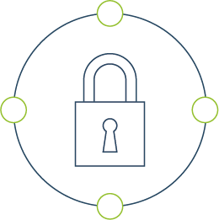

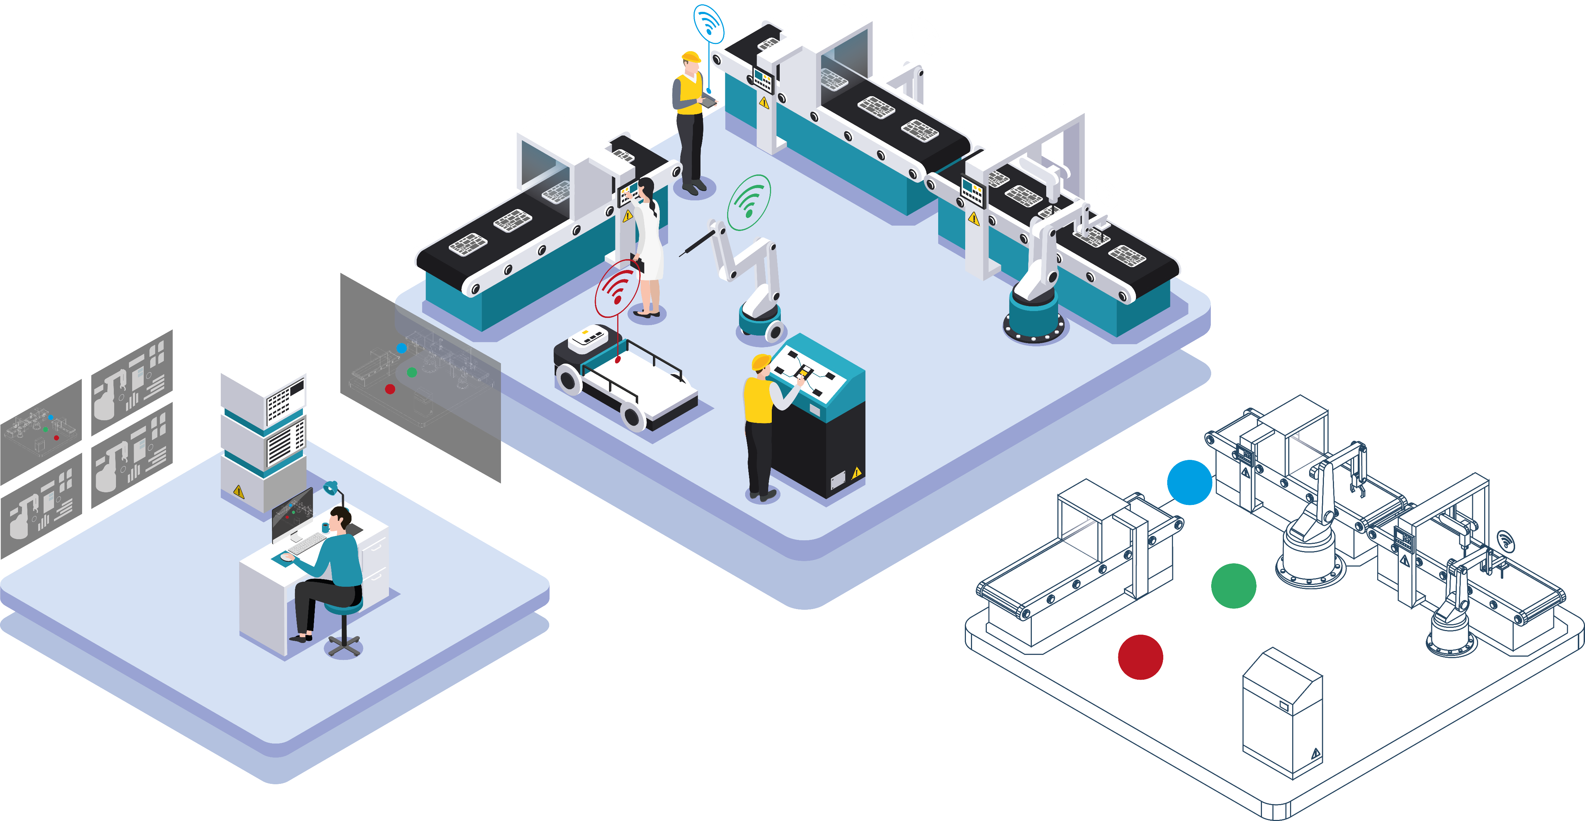
ASOCS Location Services over 5G
Real-time location - UL–TDoA and AI
Optimized for ASOCS Cyrus® platform using 3GPP standards
Seamless - outdoor and indoor
Versatile – can be used across the O-RAN compliant eco-system
Secure – calculation is conducted on the Cyrus Platform
Scalable –with network and number of connected devices
Precision Accuracy – provides <1m accuracy of connected devices

Slide 11
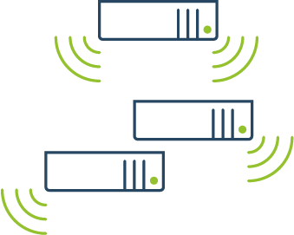
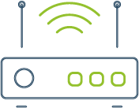


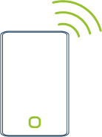

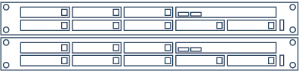

The Private 5G Network Building Blocks
NBI
5G Native Devices
Radio Units
Edge
P5G
Edge applications
CYRUS® 5G RAN
Rainbow RAN Management
Hermes Engine & LMF
DU
CU
5G Core
DU
DU
DU
DU
DU
DU
DU
DU
CPE (Devices)
Successful integration between RAN & Core

Slide 12
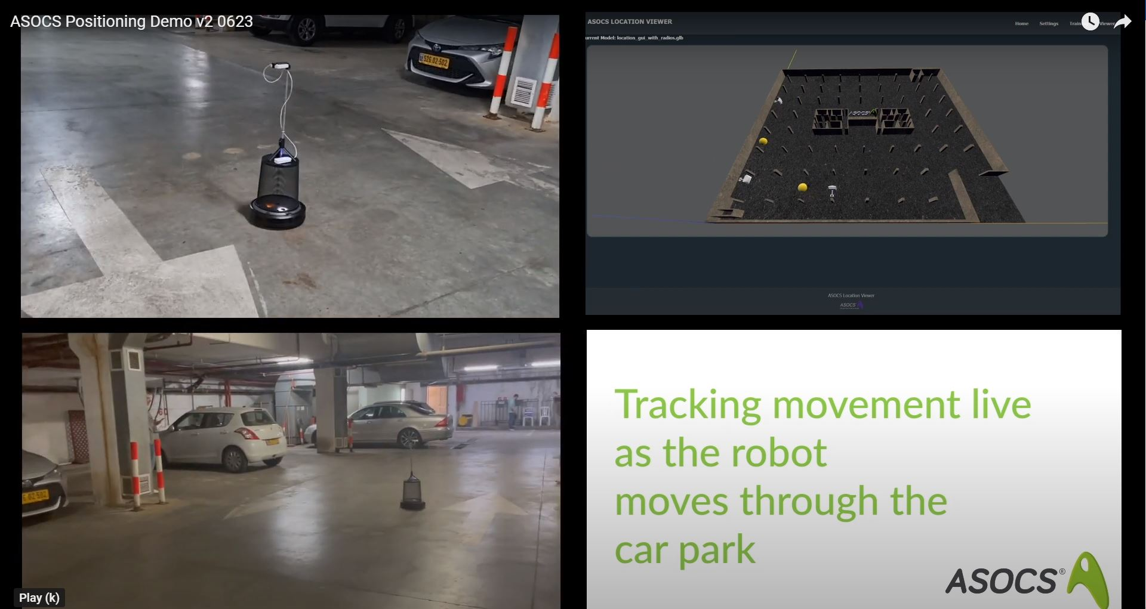

Hermes NGP - PoC

Slide 13
Thank you

